Slide 1
Model Evaluation Gain and Lift Precision, Recall, F-measure ROC Curve & AUC
Dr. Kamesam

Slide 2
Model Evaluation
Gain and Lift

Slide 3
Direct Marketing Example
Find most likely prospects to contact
Number of targets (responders) is usually much smaller than number of prospects
How can a Data Mining Model Help?
Typical Applications
retailers, catalogues, direct mail (and e-mail)
customer acquisition, cross-sell, attrition prediction
...

Slide 4
Direct Marketing Example
Data Mining can not increase number of responders!
Can Data Mining make the campaign more efficient?
Number of targets is usually much smaller than number of prospects
IDEA:
Find most likely prospects to contact
Not everybody needs to be contacted

Slide 5
CPH (Cumulative Pct Hits)
Definition:
CPH(P,M)
= % of all targets
in the first P%
of the list scored
by model M
CPH frequently
called Gains
Cumulative % Hits
Pct list
5% of random list have 5% of targets
Q: What is expected value for CPH(P,Random) ?
A: Expected value for CPH(P,Random) = P
Notes:
Potential benefit of a good customer segmentation is very high, but hard to estimate objectively. For tactical tasks, we have some analytical tools that we can use. First a brief review of the notion of lift.

Slide 6
CPH: Random List vs Model-ranked list
Cumulative % Hits
Pct list
5% of random list have 5% of targets,
but 5% of model ranked list have 21% of targets CPH(5%,model)=21%.

Slide 7
Lift
Lift(P,M) = CPH(P,M) / P
Lift (at 5%)
= 21% / 5%
= 4.2
better
than random
Note: Some authors (including Witten & Eibe) use “Lift” for what we call CPH.
P -- percent of the list

Slide 8
Direct Marketing Evaluation
Accuracy on the entire dataset is not the right measure
Approach
develop a target (responder) model
score all prospects and rank them by decreasing score
select top P% of prospects for action
How to decide what is the best selection?

Slide 9
Lift of a Predictive Model
Lift is a measure of the effectiveness of a predictive model calculated as the ratio between the results obtained with and without the predictive model.
Cumulative gains and lift charts are visual aids for measuring model performance
Both charts consist of a lift curve and a baseline
The greater the area between the lift curve and the baseline, the better the model

Slide 10
Precision, Recall, and F measure
(can be computed for each class)

Slide 11
Metrics for Performance Evaluation…
 | PREDICTED CLASS
ACTUAL CLASS |  | Class=P | Class=N
 | Class=P | a (TP) | b (FN)
 | Class=N | c (FP) | d (TN)
Again, Remember: We are concerned about accuracy on “UNSEEN” data and NOT the training data
Error Rate = 1 - Accuracy

Slide 12
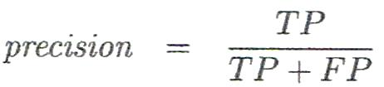
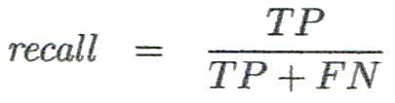
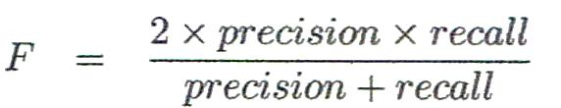
Other Classifier Evaluation Metrics
Precision
% of instances that the classifier predicted as positive that are actually positive
Recall
% of positive instances that the classifier predicted correctly as positive
a.k.a “Completeness”
Perfect score for both is 1.0, but there is often a trade-off between Precision and Recall
F measure (F₁ or F-score)
harmonic mean of precision and recall

Slide 13
F measure

Slide 14
Model Evaluation
ROC Curve,
and AUC (Area under the curve)

Slide 15
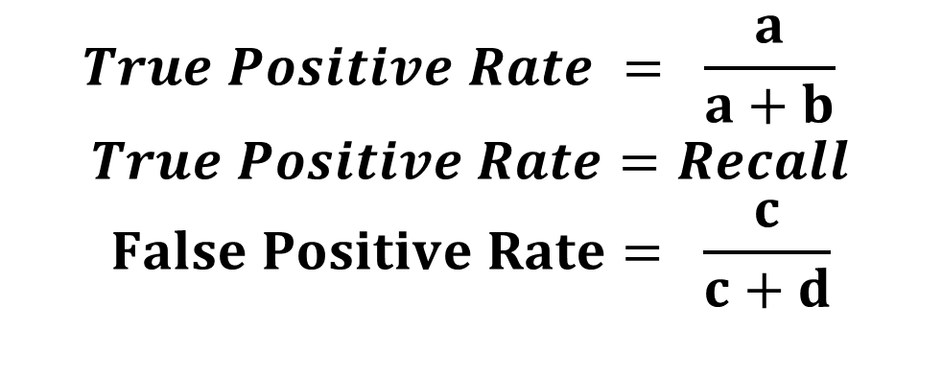
True Positive Rate , False Positive Rate
$$True Positive Rate = \frac{a}{a+b}$$
$$True Positive Rate=Recall$$
$$False Positive Rate= \frac{c}{c+d}$$
 | PREDICTED CLASS
ACTUAL CLASS |  | Class= + | Class= -
 | Class= + | a (TP) | b (FN)
 | Class= - | c (FP) | d (TN)

Slide 16
ROC curve comparison
A good classifier:
A poor classifier
100%
100%
True Positive Rate
True Positive Rate
0%
0%
0%
False Positive Rate
100%
0%
False Positive Rate
100%

Slide 17
ROC curve extremes
Best
No Good
100%
100%
True Positive Rate
True Positive Rate
0%
0%
0%
100%
0%
100%
False Positive Rate
False Positive Rate

Slide 18
AUC for ROC curves
100%
100%
AUC = 100%
True Positive Rate
True Positive Rate
AUC = 50%
0%
0%
0%
100%
0%
False Positive Rate
100%
False Positive Rate
100%
100%
AUC = 90%
True Positive Rate
True Positive Rate
AUC = 65%
0%
0%
0%
False Positive Rate
100%
0%
100%
False Positive Rate

Slide 19
Interpretation of AUC
AUC can be interpreted as the probability that the test result from a randomly chosen diseased individual is more indicative of disease than that from a randomly chosen nondiseased individual: P(X_{i} ≥ X_{j} | D_{i} = 1, D_{j} = 0)
So can think of this as a nonparametric distance between disease/nondisease test results

